Slide 1
Wine Quality Prediction (An Analysis Using Logistic Regression, Random Forest, and SVM)
Presented By: Namita S

Slide 2
Contents
Introduction
Problem Definition
Data Collection
Methodology
Data Visualization & Exploratory Data Analysis (EDA)
Default Vs. Optimized Model Performance
Model Deployment & Prediction
Conclusion & Insights

Slide 3
Introduction
Wine Quality Prediction: An Overview
Wine quality is influenced by various chemical properties such as acidity, sugar content, and alcohol percentage.
Traditional wine quality assessment relies on human experts, which can be subjective and time-consuming.
Importance of Predicting Wine Quality
Helps winemakers maintain consistent quality and optimize production.
Reduces dependency on manual testing, saving time and cost.
Aids in quality control and market pricing decisions.
How Machine Learning Can Help
Machine learning models analyze historical wine data to find patterns and predict quality.
Automates the prediction process with high accuracy.
Enables wineries to take data-driven decisions for improvement.

Slide 4
Problem Definition
Problem Statement:
The goal of this project is to predict the quality of wine based on its chemical properties using machine learning models.
By leveraging machine learning, we can build an automated and objective system to classify wine as high-quality or low-quality based on its features.
Why is this Important?
Helps wine producers ensure consistency in quality.
Reduces reliance on human tasting, which is costly and inconsistent.
Provides a data-driven approach to wine quality assessment.
Challenges in Wine Quality Prediction:
Complex Feature Relationships – Wine quality depends on multiple interacting chemical components.
Choosing the Right Model – Finding the best machine learning algorithm for accurate predictions.
Hyperparameter Tuning – Optimizing models for better accuracy.

Slide 5
DATA Collection
📌 Dataset Used: Red Wine Quality Dataset (From Kaggle)
📊 Dataset Overview:
Number of Samples: 1,599 wines
Number of Features: 11 chemical properties
Target Labels:
0 → Low Quality Wine
1 → Good Quality Wine
📌 Data Source:
The dataset was sourced from the UCI Machine Learning Repository.
It contains chemical compositions of red wine samples along with their quality ratings, allowing us to train models for classification.
🔍 Why This Dataset?
Provides real-world chemical attributes influencing wine quality.
Useful for predicting wine quality based on measurable factors.
Helps winemakers improve production & quality control.

Slide 6
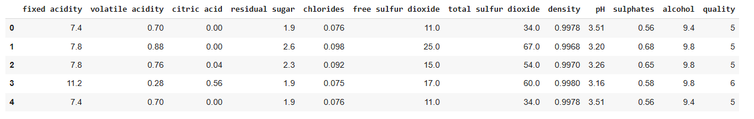
A model Of the Data used (First 5 Rows):

Slide 7
METHODOLOGY
Model Selection & Explanation: We implemented three machine learning models for predicting wine quality. Each model was chosen based on its unique strengths:
LOGISTIC REGRESSION
RANDOM FOREST
SUPPORT VECTOR MACHINE
🔹 Why We Used It?
A simple and interpretable model that helps understand how each chemical property affects wine quality.
Works well for binary classification (Good vs. Low Quality).
🔹 How We Used It?
Trained the model on wine features to determine the probability of a wine being high or low quality.
Applied regularization to prevent overfitting.
🔹 Why We Used It?
A powerful ensemble method that combines multiple decision trees to make better predictions.
Handles complex relationships between features and reduces overfitting.
🔹 How We Used It?
Trained multiple decision trees on different parts of the data and averaged the results for better accuracy.
Identified the most important features influencing wine quality.
🔹 Why We Used It?
Works well with complex datasets by finding the best boundary to separate good and low-quality wines.
Can handle non-linear relationships using different kernel functions.
🔹 How We Used It?
Used different kernels to capture patterns in the data.
Optimized hyperparameters to improve accuracy.

Slide 8

🔍 Models Used: Explanation & Mathematical Equations
1️⃣ Logistic Regression (LR) – Probabilistic Model
Logistic Regression predicts the probability that a given input belongs to one of two categories (0 = Low Quality, 1 = Good Quality).
Uses the sigmoid function to map predictions between 0 and 1:
β coefficients are learned through optimization (Maximum Likelihood Estimation).
✅ Used for: Simple classification problems where relationships between features and labels are linear.

Slide 9
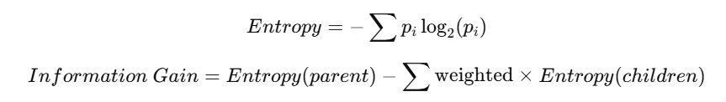
2️⃣ Random Forest – Ensemble of Decision Trees
A Random Forest is a collection of decision trees, where:
Each tree makes a prediction.
The final result is determined by majority voting (classification).
Decision Tree Splitting Rule (Entropy & Information Gain):
✅ Used for: Handling non-linear relationships, high-dimensional data, and preventing overfitting.

Slide 10

3️⃣ Support Vector Machine (SVM) – Hyperplane-Based Model
SVM finds the optimal hyperplane that best separates the data into two categories.
The hyperplane is defined as:
where w is the weight vector and b is the bias.
Kernel Trick: If data is not linearly separable, we apply a kernel function (e.g., RBF Kernel) to project it into a higher-dimensional space.
✅ Used for: Complex classification tasks where data is not linearly separable.

Slide 11


Workflow of Wine Quality Prediction
Data Collection
Model Deployment & Prediction
Exploratory Data Analysis (EDA)
Optimized Model Evaluation
Hyperparameter Tuning (GridSearchCV)
Data Preprocessing (Scaling, Splitting)
Performance Evaluation (Default Accuracy)
Model Selection (Logistic Regression, Random Forest, SVM)

Slide 12
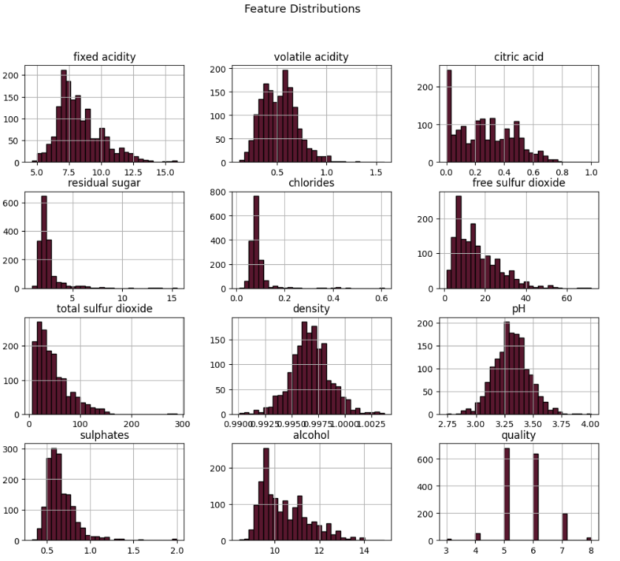
Data Visualization & Exploratory Data Analysis (EDA)
Key Explorations in EDA
1️⃣ Feature Distributions – Histograms & Boxplots

Slide 13
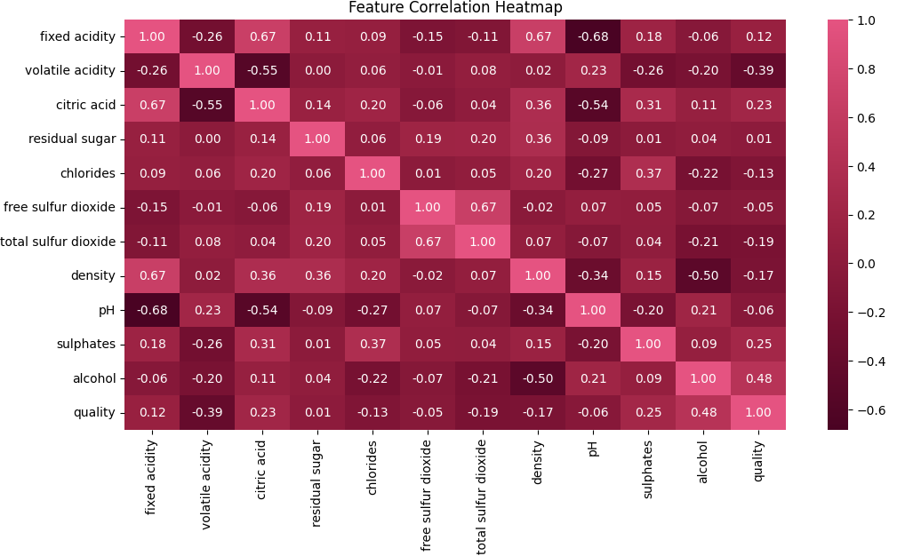
2️⃣ Correlation Heatmap – Relationship Between Features

Slide 14
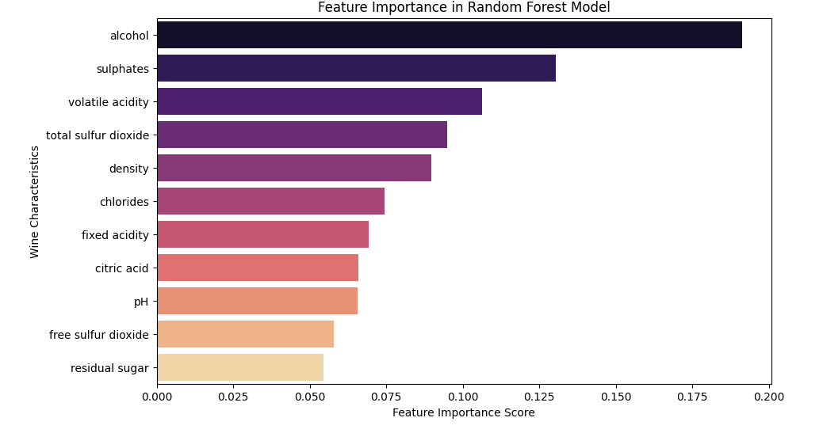
3️⃣ Feature Importance – Random Forest

Slide 15
📌 Key Takeaways from EDA
✅ Alcohol is the most important predictor of good wine quality. ✅ High volatile acidity negatively affects wine quality. ✅ Fixed acidity, citric acid, and pH have moderate impact but are not the strongest indicators.

Slide 16
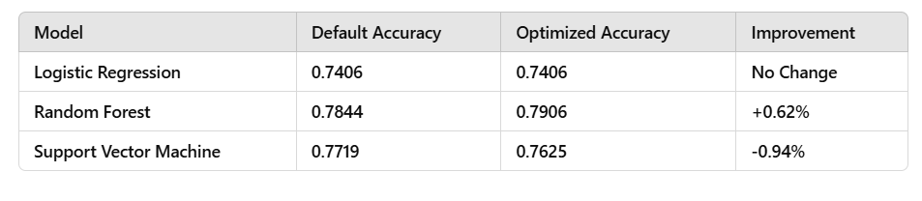
DEFAULT VS. OPTIMIZED MODEL PERFORMANCE COMPARISON
Here’s a table comparing Default Accuracy vs. Optimized Accuracy for all three models after hyperparameter tuning.

Slide 17
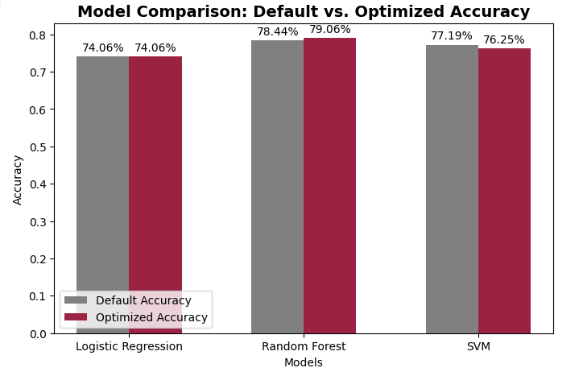

Slide 18
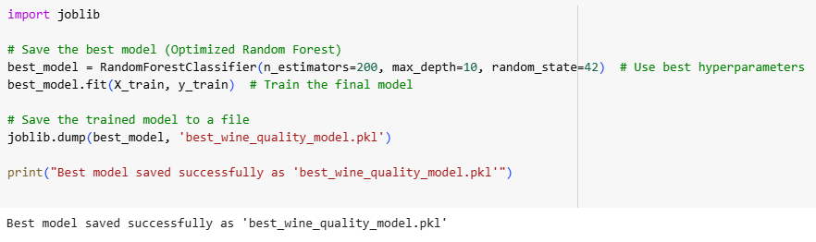
MODEL DEPLOYMENT AND PREDICTION
🚀 How We Saved the Best Model
After evaluating all models, Random Forest performed the best after hyperparameter tuning. We saved this optimized model using Joblib, allowing it to be reused for predictions without retraining.

Slide 19
CONCLUSION AND INSIGHTS
🏆 Best Performing Model
Random Forest (Optimized) achieved the highest accuracy of 79.06% after hyperparameter tuning.
It performed better than Logistic Regression and SVM due to its ability to handle non-linear relationships and capture feature interactions.
⚡ Impact of Hyperparameter Tuning
Random Forest: Improved from 78.44% → 79.06%, refining tree depth and feature selection.
SVM: Slight decrease from 77.19% → 76.25%, likely due to overfitting or kernel selection.
Logistic Regression: No improvement, as linear models often have limited tuning flexibility.
🔑 Key Takeaways
✔ Random Forest was the best model for wine quality prediction. ✔ Hyperparameter tuning helped improve accuracy slightly, mainly for Random Forest. ✔ Key chemical properties (Alcohol, Acidity, Sulfur Dioxide) strongly impact wine quality.

Slide 20
THANK YOU!

